Slide 1

Analysis of Factors Influencing Fine Dust
SeonYoung Jhang

Slide 2
Table of Contents
Project Overview
Project Objective
Data Preparation
Data Cleansing
EDA
Modeling
Model Evaluation
Conclusion

Slide 3

Project Overview
What is Fine Dust? Fine dust is particulate matter that can be found in the air that is incredibly small – containing air pollutants such as sulfur dioxide, nitrogen oxides, lead, ozone, carbon monoxide, etc. These pollutants are emitted from sources like automobiles, factories, and cooking processes, and consist of fine particles with a diameter of 10 ㎛ or less, which can linger in the air for an extended period
The Impact of Fine Dust on Our Lives: - Health Prolonged exposure to fine dust can adversely affect human health. - Environment When fine dust accumulates in vinyl greenhouses, it can lead to reduced sunlight and disruption of photosynthesis in crops, contributing to soil degradation - Economy Economic losses occur due to the negative impact of fine dust, causing economic downturns and affecting industries sensitive to fine dust, such as semiconductors and displays. (estimated economic losses amount to approximately KRW 4.23 trillion annually – Hyundai Economic Research Institute)
Notes:
3

Slide 4
Project Overview
In the Ministry of Environment’s report on domestic environmental trends, the causes of fine dust are analyzed as follows: 1) Domestic Factors The proportion of domestically generated fine dust is 50-70% : 51% of fine dust in Seoul being domestically produced. : 68.2% are particles released through the combustion of fossil fuels. 2) International Factors Approximately 43% of domestic fine dust is attributed to factors such as emissions from factories and vehicle exhaust in China, as well as desert dust.
Other related Information 1) Direction of the Wind When winds from the west blow, the concentration of fine dust is high 2) Speed of the Wind In the wind speed range of 0-6 m/s, the highest concentration occurs during calm conditions and the concentration decreases as wind speed increases. Beyond 6 m/s, the concentration increases with the rising wind speed. 3) Weather On days with yellow dust or foggy weather, the concentration of fine dust tends to be high 4) Humidity When the humidity is between 60% and 90%, the fine dust concentration is elevated. High humidity promotes the formation of secondary particulate matter in the atmosphere, such as sulfuric and nitric acid salts.
Meteorological Variable
Domestic Factors
Atmospheric
Variable
International
Factors
Notes:
4

Slide 5
Project Objective
The background information indicated that various factors influence the concentration of fine dust.
Therefore, there is a need to verify whether the given fine dust-related data aligns with these background information based on the understanding the fine dust.
Given the multifaceted negative impacts of fine dust, the goal is to better identify factors influencing fine dust and to develop a prediction model of its occurrence amount

Slide 6
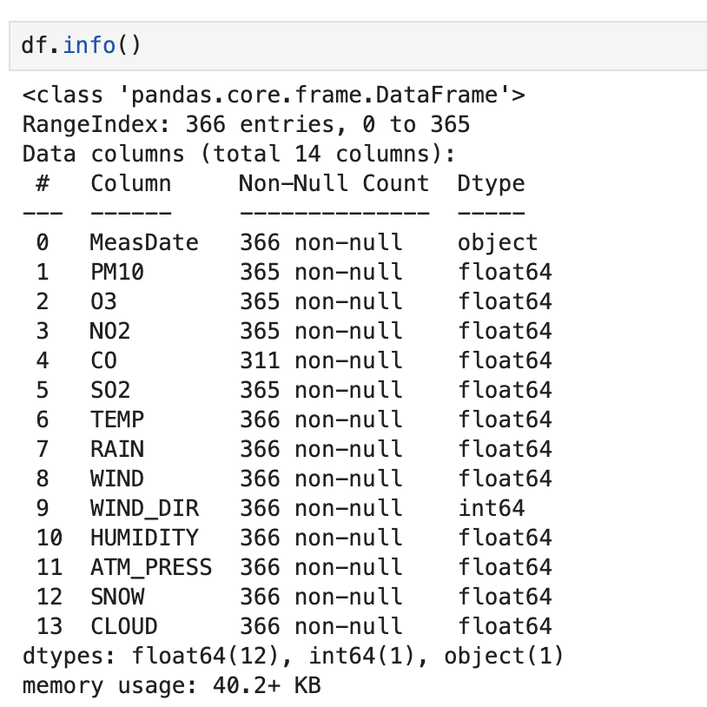
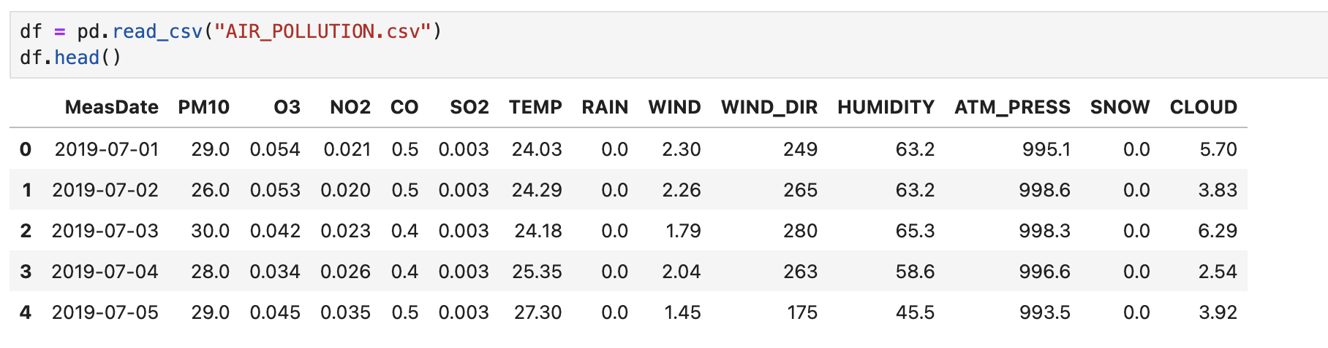
Data Preparation
Jul 1st, 2019 ~ June 30th, 2020
Target Variable: PM10
Independent Variable: O3, NO2, CO, SO2, TEMP, RAIN, WIND, WIND_DIR, HUMIDITY, ATM_PRESS, SNOW, CLOUD
Data shape: (365, 13)
Notes:
PM10 CO 계절 HUMIDITY TEMP ATM_PRESS WINDDIR SO2

Slide 7
Data Preparation
Target Variable
Atmospheric Variable
Meteorological Variable
Datetime Variable
Variable | Details
PM10 | Particulate Matter 10㎍/㎥
Variable | Details
O3 | Ozone Concentration
NO2 | Nitrogen Dioxide Concentration
CO | Nitric Oxide Concentration
SO2 | Sulfur Dioxide Concentration
Variable | Details
TEMP | Temperature (°C)
RAIN | Precipitation (mm)
WIND | Wind Speed (m/s)
WIND_DIR | Wind Direction (16Cardinal Directions)
HUMIDITY | Humidity(%)
ATM_PRESS | Atmospheric Pressure(hPa)
SNOW | Snowfall(cm)
CLOUD | Cloud Cover (in tenths)
Season | Four Seasons
Variable | Details
MeasDate | Measured Date
Derived Variable
Variable | Details
Season | Four Seasons
- Winter: Dec – Feb
- Spring: Mar – May
- Summer: Jun – Aug
- Fall: Sep – Nov
Notes:
PM10 CO 계절 HUMIDITY TEMP ATM_PRESS WINDDIR SO2

Slide 8
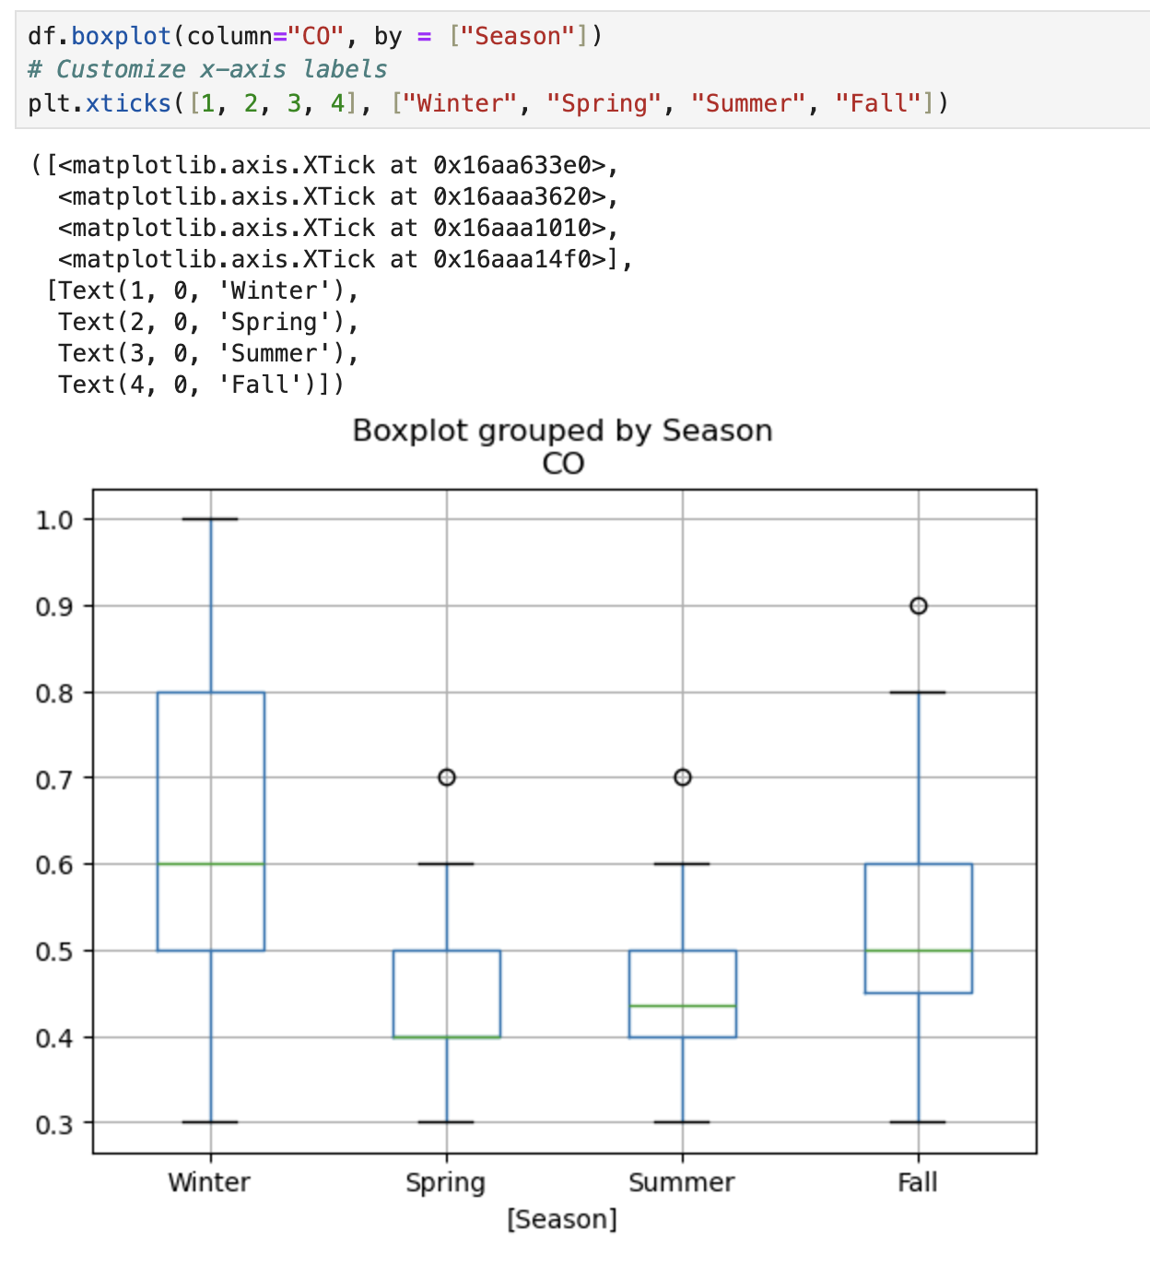
Data Cleansing
Null Values
Variable | # of Null
PM10 | 1
O3 | 1
NO2 | 1
CO | 55
SO2 | 1
- Multiple missing values were identified in 2020-05-02
→ replaced by the average value by season
- For CO, input the average value by season
The combination of the boxplot and ANOVA results confirms that `CO` levels differ significantly across seasons. The low p-value (< 0.05) provides strong statistical evidence for this conclusion, and the high F-statistic further supports the existence of meaningful differences between seasonal groups.
Notes:
PM10 CO 계절 HUMIDITY TEMP ATM_PRESS WINDDIR SO2

Slide 9
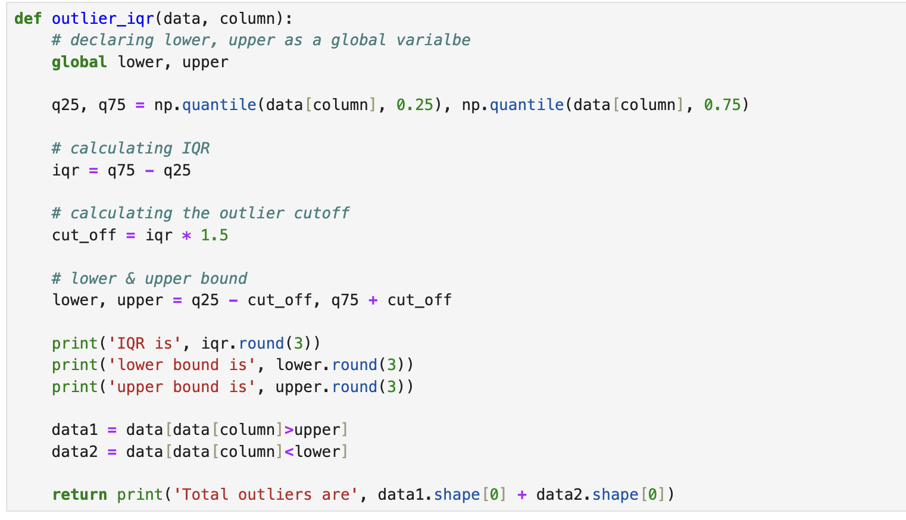
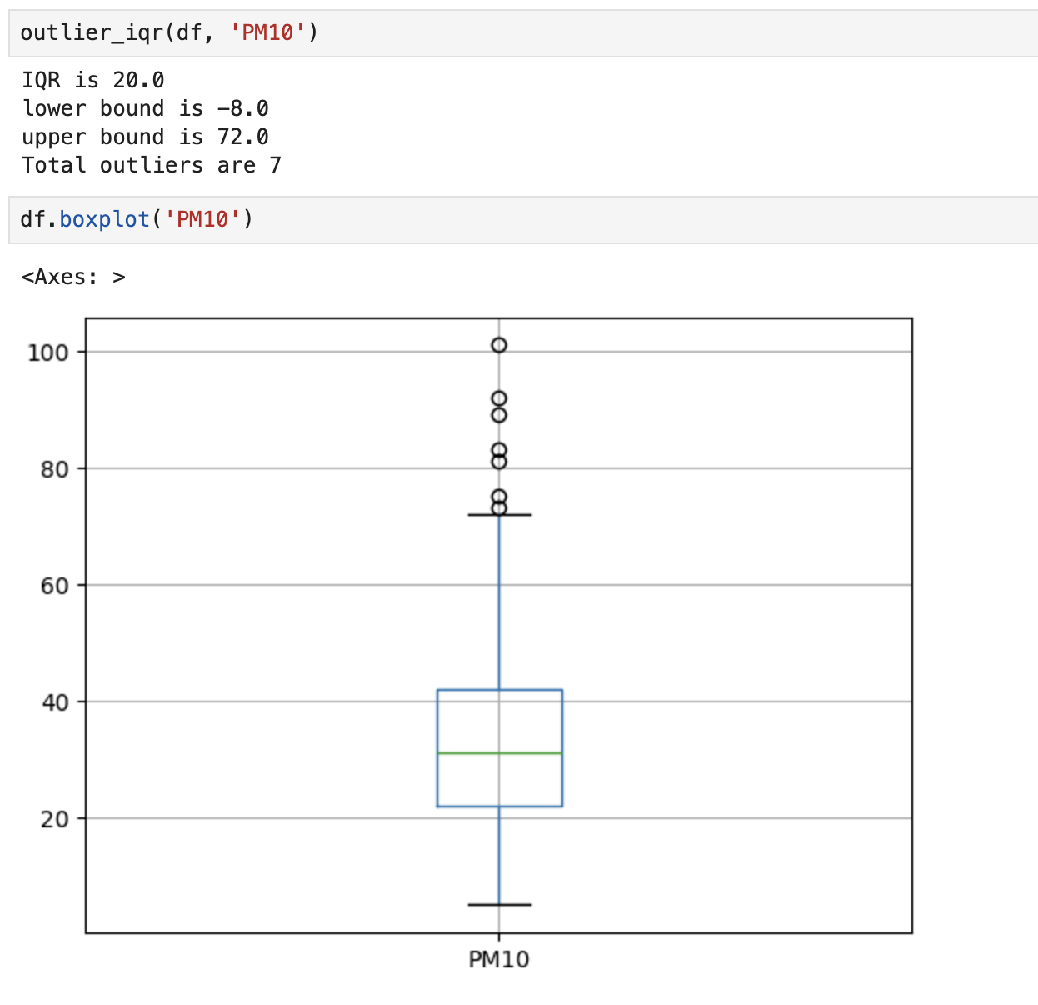
Data Cleansing
Outliers
Using user-defined function
Detecting outliers for each variable
However, no separate handling for outliers is done
example
Notes:
PM10 CO 계절 HUMIDITY TEMP ATM_PRESS WINDDIR SO2

Slide 10
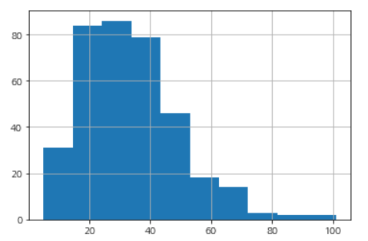
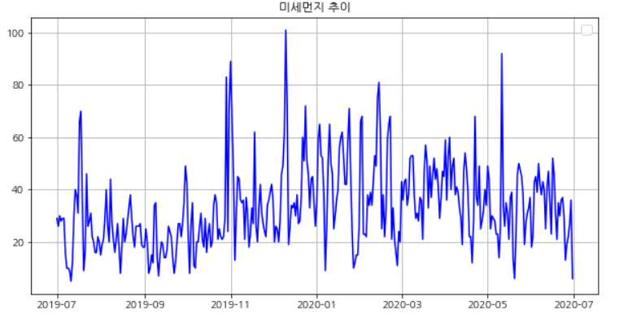
EDA
1) Target Variable (PM10)
Checking the distribution through a Histogram
Verifying the trend of fine dust over time using a Line Graph.
Notes:
PM10 CO 계절 HUMIDITY TEMP ATM_PRESS WINDDIR SO2

Slide 11
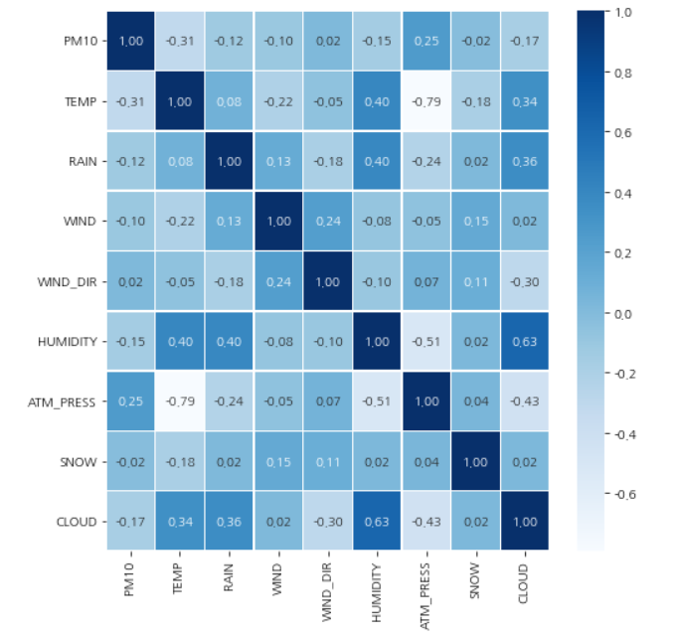
EDA
2) Independent Variables
The given X variables were grouped based on two main criteria
1) Meterological Variables : TEMP, RAIN, WIND, WIND_DIR, HUMIDITY, ATM_PRESS, SNOW, CLOUD
→ There is no significant correlation with PM10
Notes:
PM10 CO 계절 HUMIDITY TEMP ATM_PRESS WINDDIR SO2

Slide 12
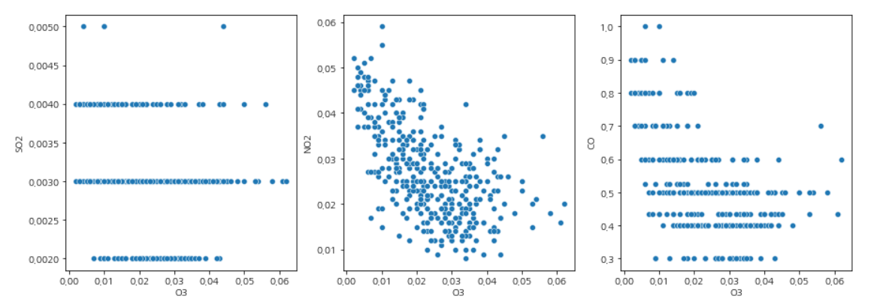
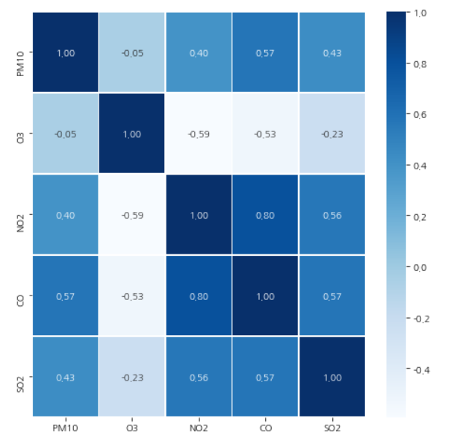
Data Visualization
2) Independent Variables
The given X variables were grouped based on two main criteria
2) Atmospheric Variable : O3, NO2, CO, SO2
→ O3: Not directly influenced by PM10.
However, it shows a negative correlation with SO2, NO2, and CO as observed in the scatter plots. In other words, while O3 may not have a direct impact, but it is indirectly associated
Correlation Analysis with PM10
 | Correlation | P-value
NO2 | 0.396 | 0.000
CO | 0.573 | 0.000
SO2 | 0.428 | 0.000
O3 | -0.051 | 0.326
→ There is a correlation between PM10 and NO2, CO, and SO2.
Notes:
PM10 CO 계절 HUMIDITY TEMP ATM_PRESS WINDDIR SO2

Slide 13
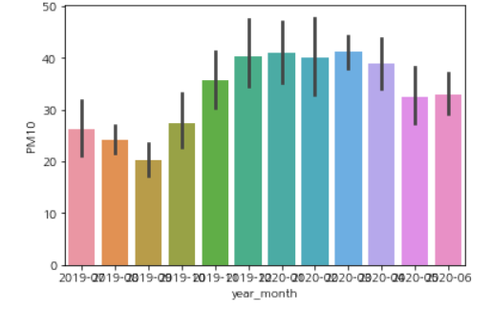
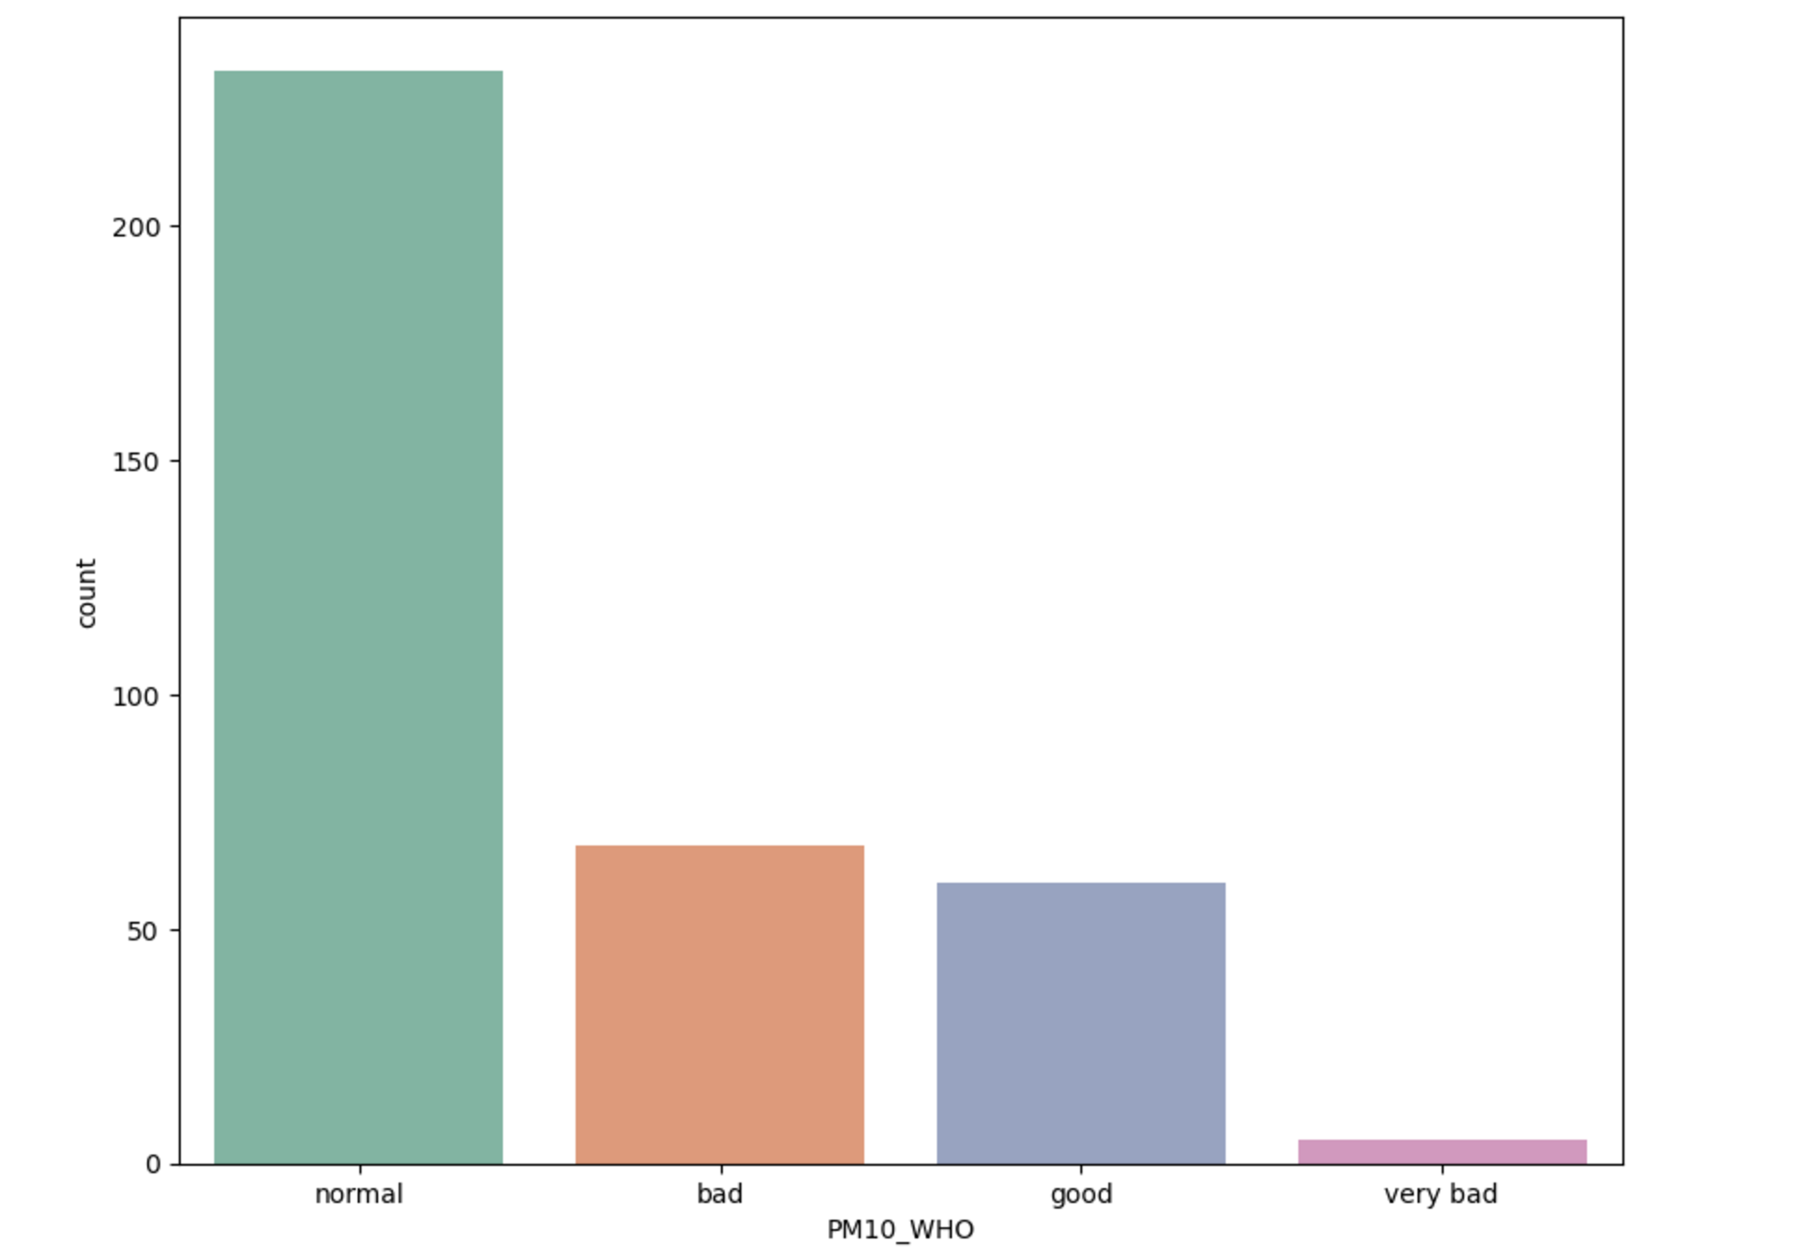
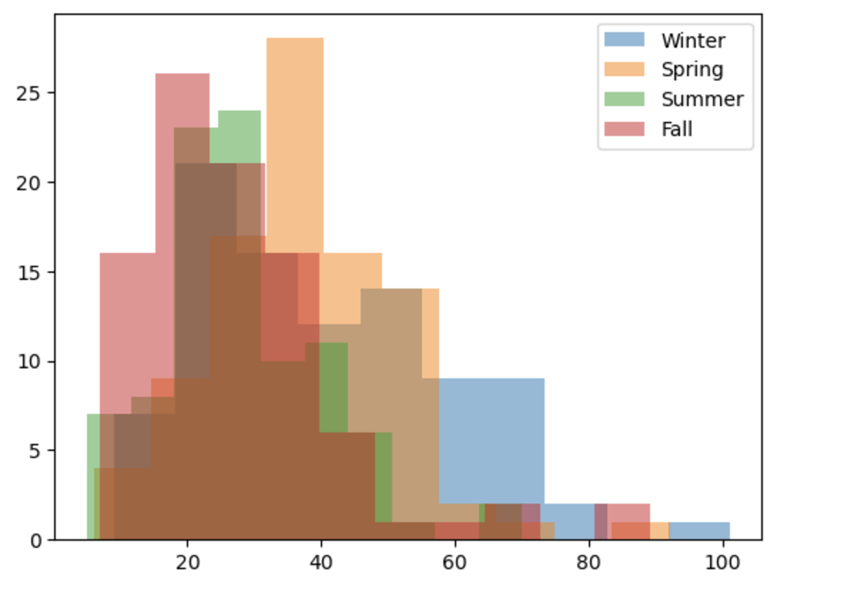
EDA
3) Derived Variables
PM10_WHO
: Categorized according to WHO standards into Good/Normal/Bad/Very Bad
Season
→ PM10 exhibiting varying trends across different seasons
→ Particularly high levels of PM10 are observed during the winter.
Notes:
PM10 CO 계절 HUMIDITY TEMP ATM_PRESS WINDDIR SO2

Slide 14
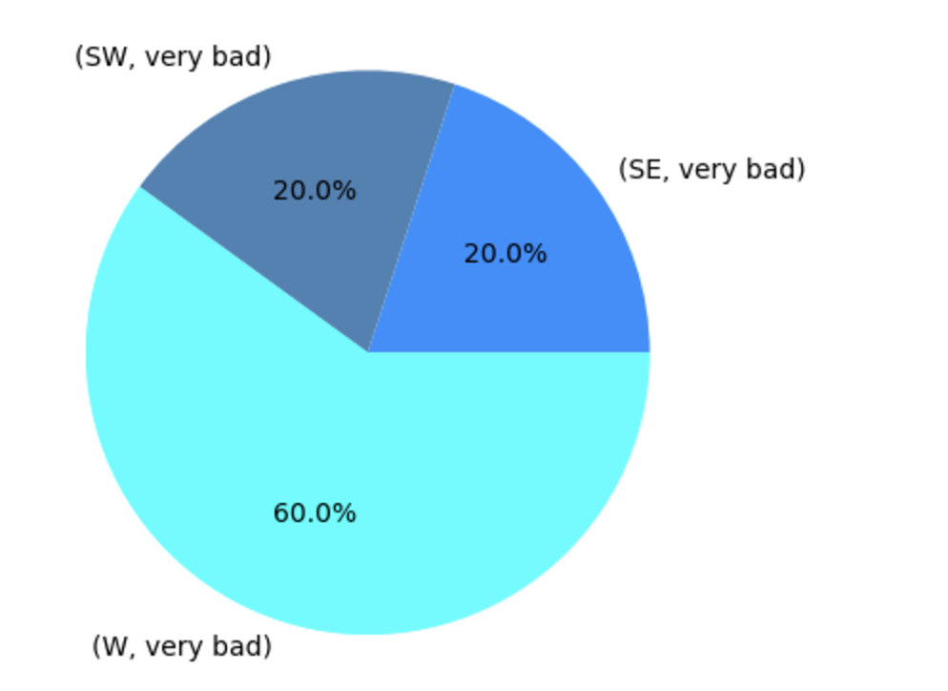
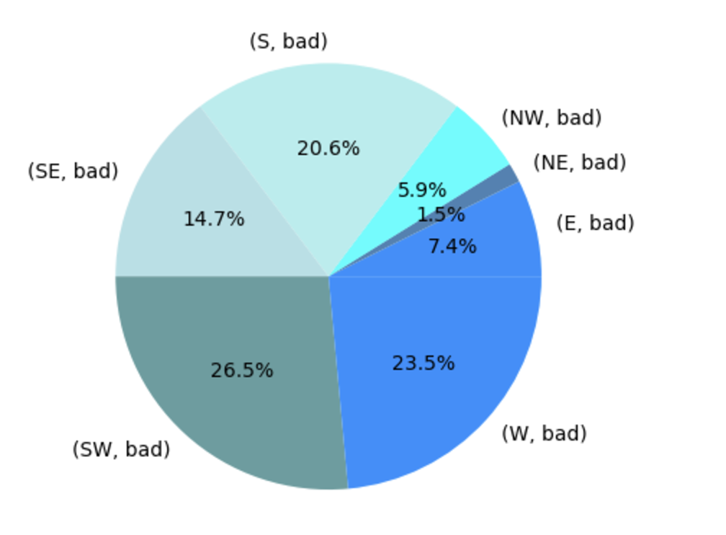
EDA
3) Derived Variables
- Wind Direction
In cases where PM10 is categorized as 'Very Bad' or 'Bad', W (west) and SW (southwest) directions account for more than 50%.
Notes:
PM10 CO 계절 HUMIDITY TEMP ATM_PRESS WINDDIR SO2

Slide 15
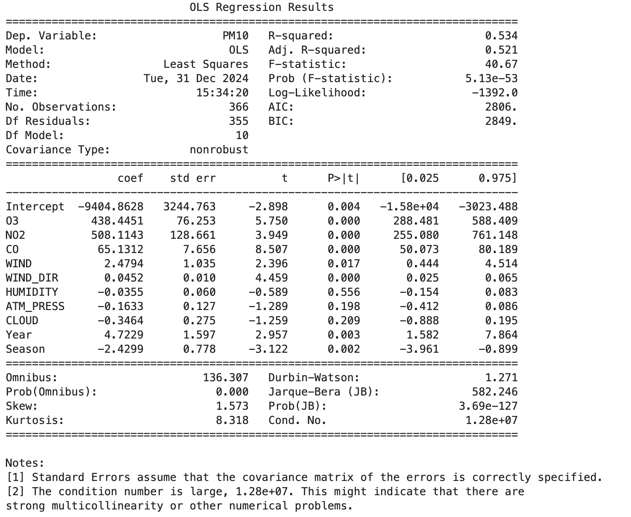
Modeling
Multiple Linear Regression
R-squared: The model can explain 56.4%
Prob(F-statistics): 5.13e-53, considered to be statistically significant
Final Model Regression Equation
Y_hat = -9404.8628 + 438.4451 O3 + 508.1143 NO2 + 65.1312 CO – 2.4794 WIND + 0.0452 WIND_DIR – 0.0355 HUMIDITY – 0.1633 ATM_PRESS -0.3464 CLOUD + 4.7229 Year -2.4299 Season
MAPE: 25.28
Judged as a highly reasonable prediction as it is below 50. (Tofallis, 2016)

Slide 16
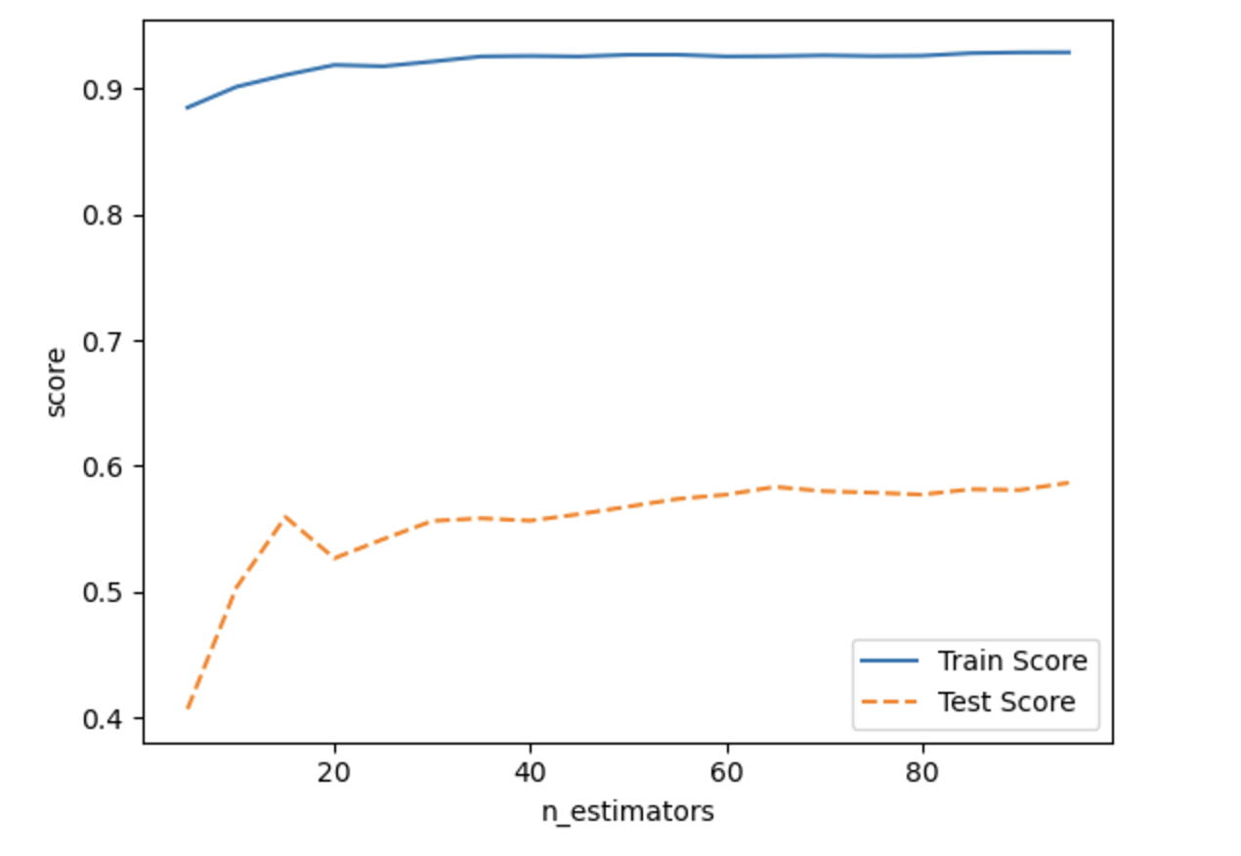
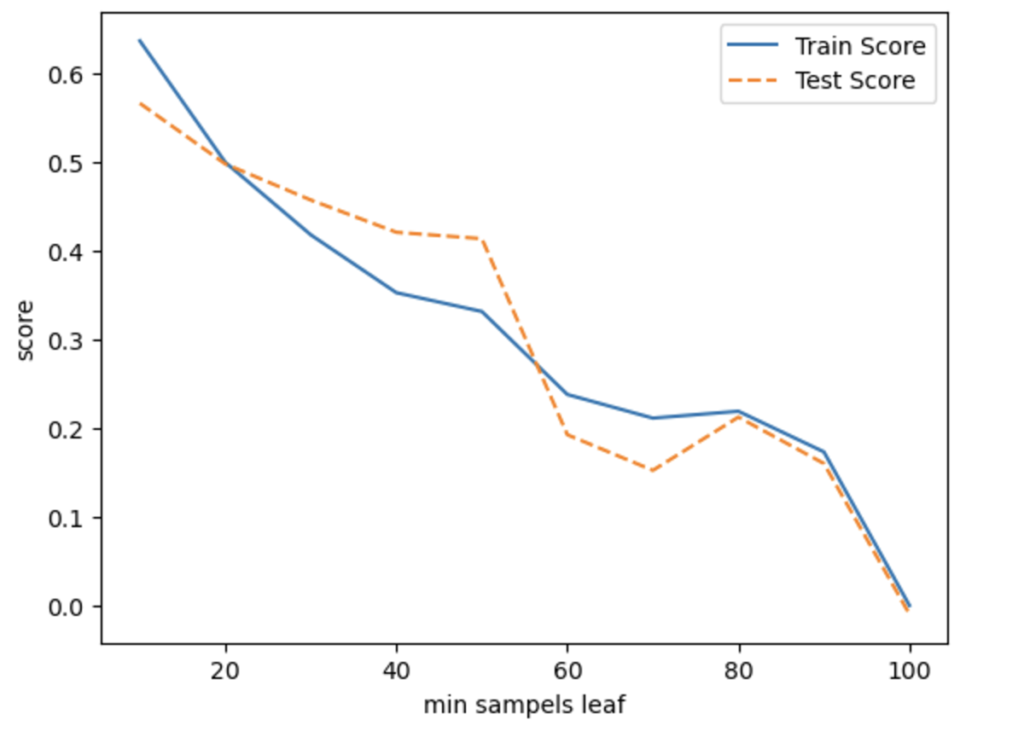
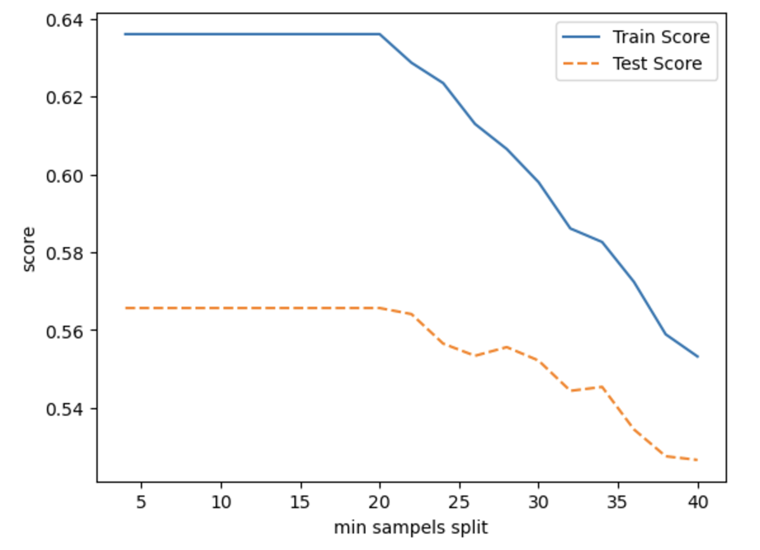
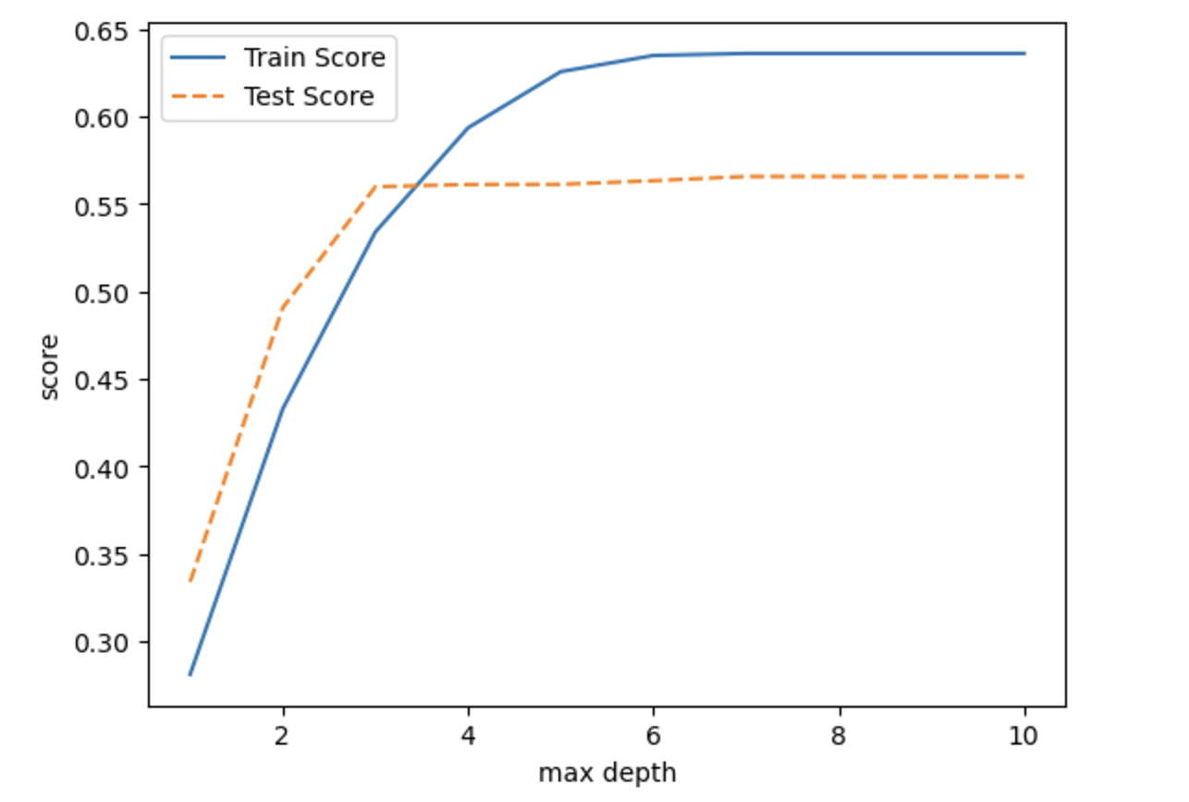
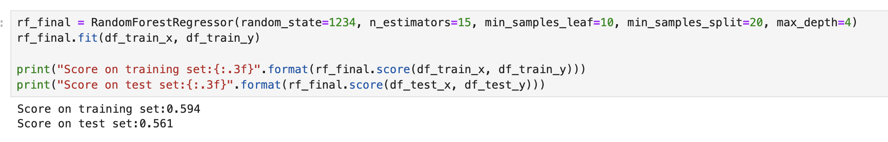
Modeling
Random Forest
Split train and validation data into 20:80
# of trees
# of leaves
# of splits
Max depth
Final Random Forest Regressor Model
N_estimator: 15
Leaf: 10
Split : 20
Max depth: 4
With this model, the score on the test set was 0.561

Slide 17
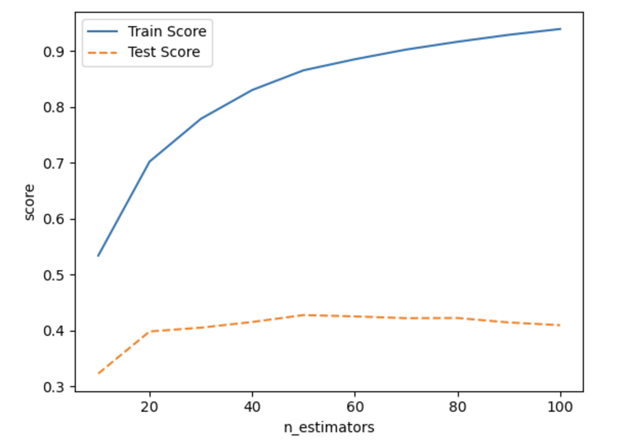
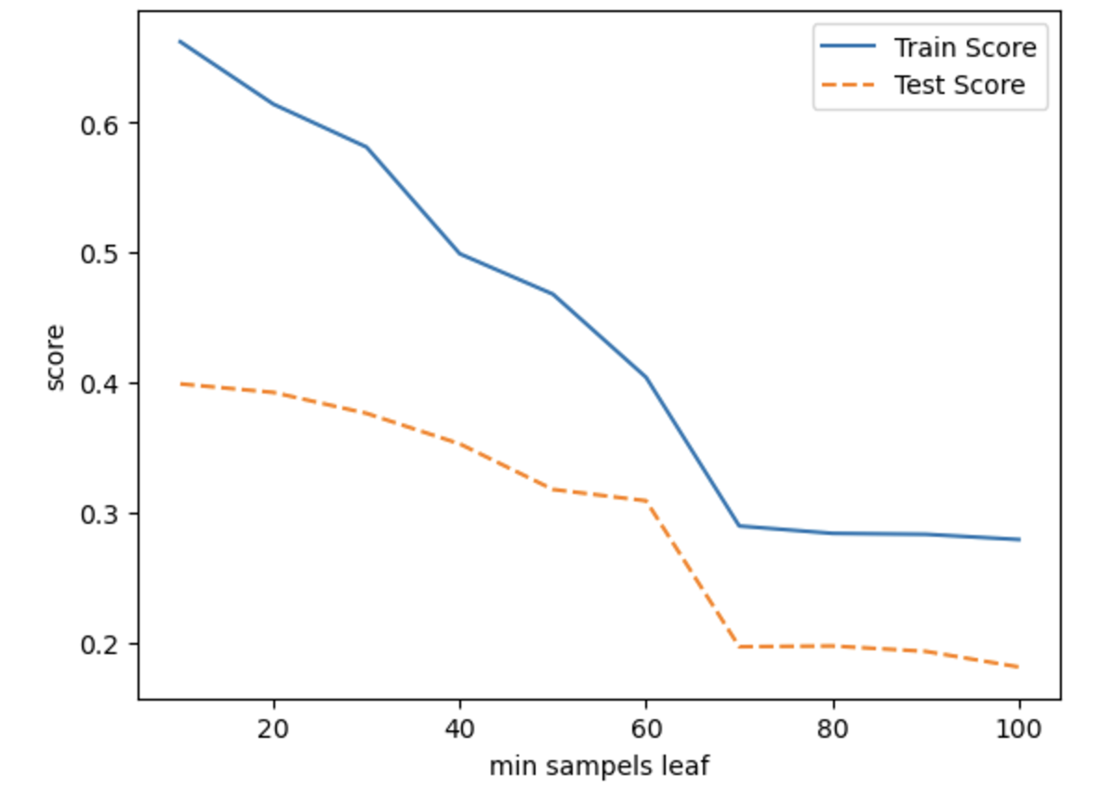
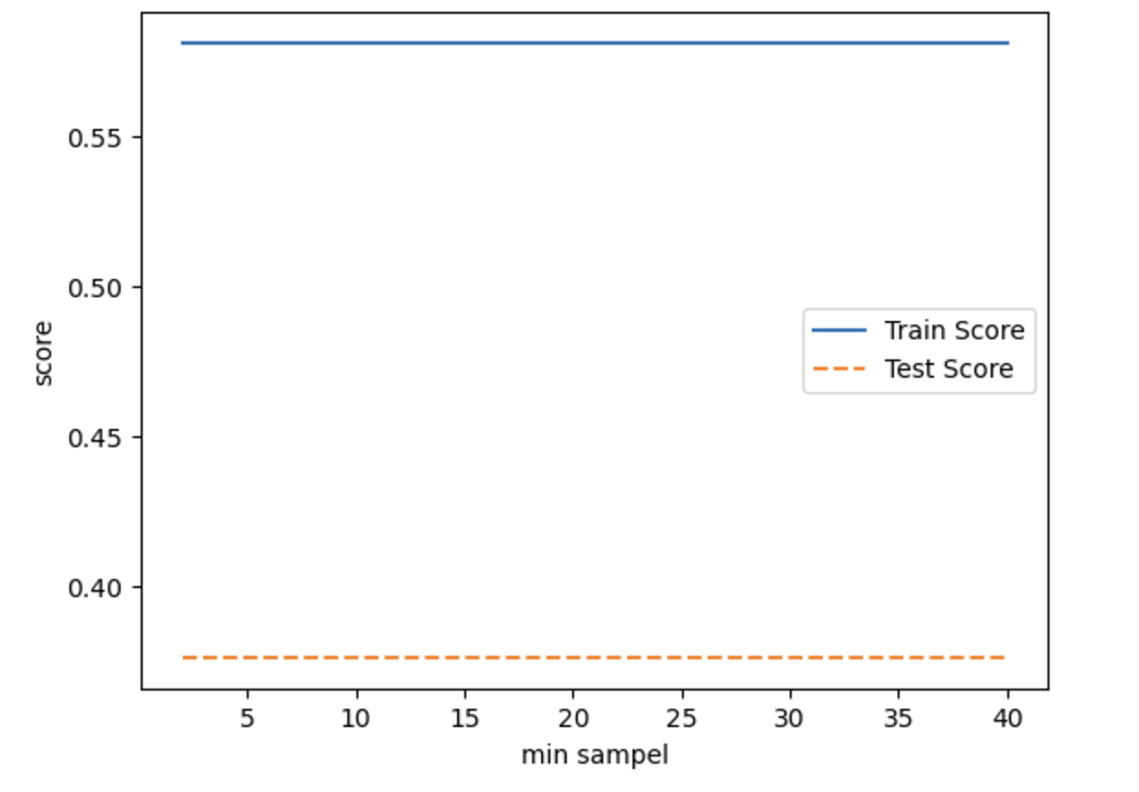
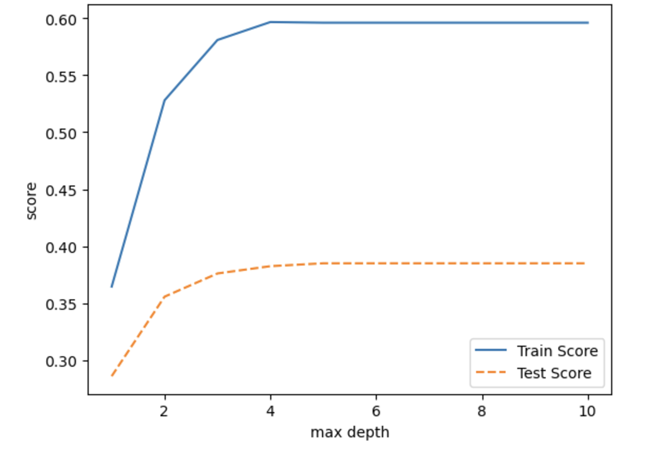
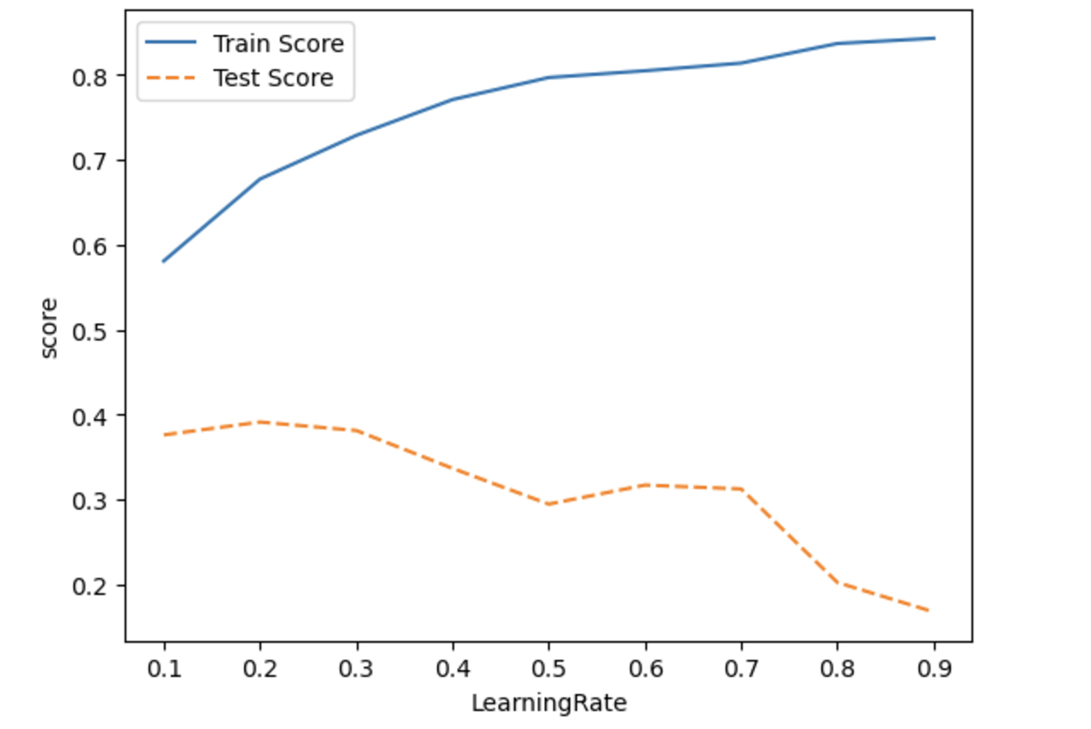
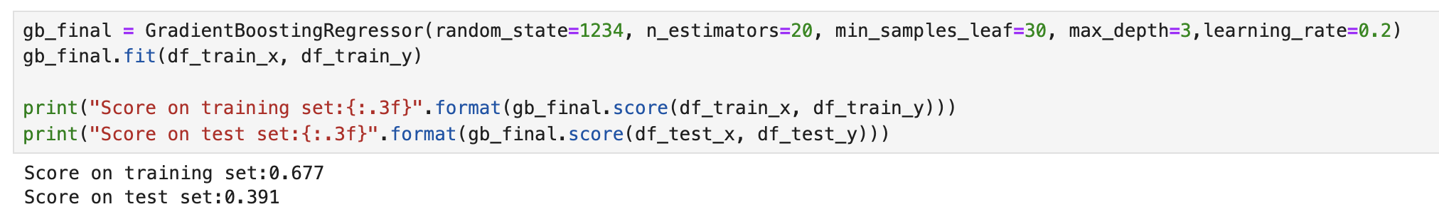
Modeling
Gradient Boosting
Split train and validation data into 20:80
# of trees
# of leaves
# of splits
Max depth
Learning rate
Final Gradient Boosting Model
N_estimator: 20
Leaf: 30
Split : -
Max depth: 3
Learning rate: 0.2
With this model, the score on the test set was 0.391

Slide 18
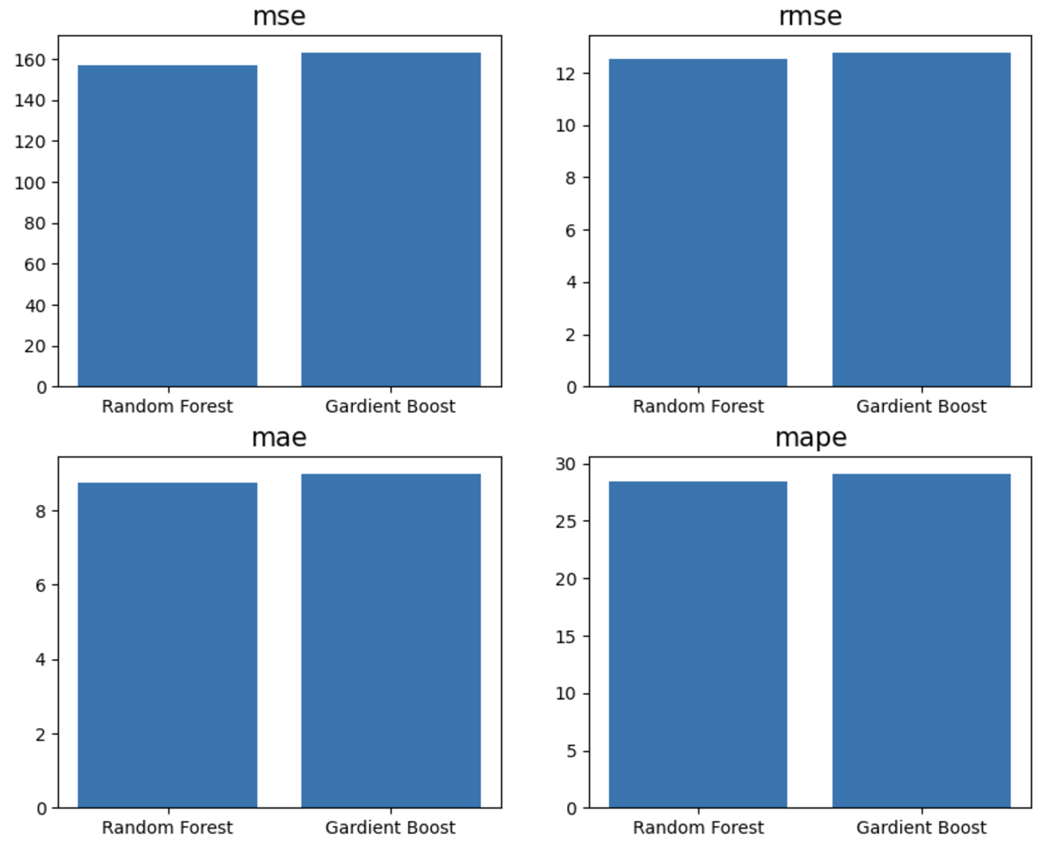
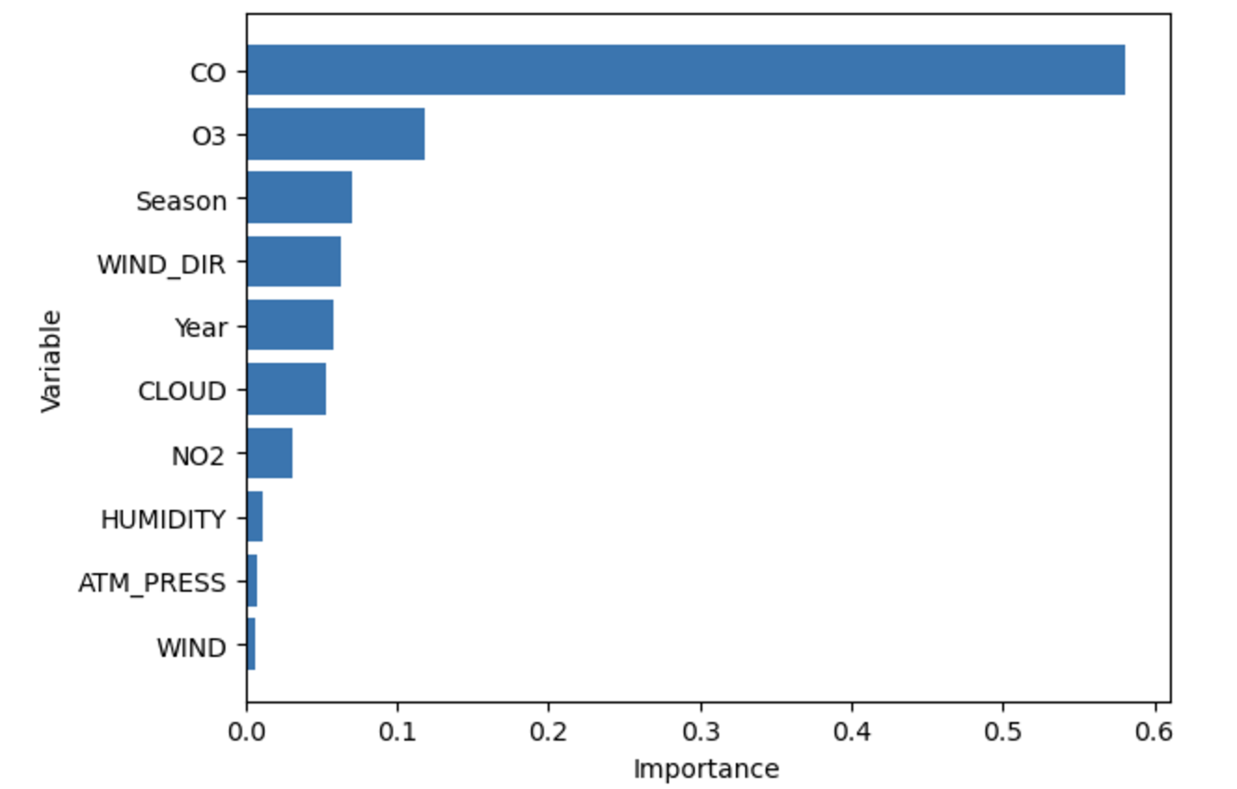
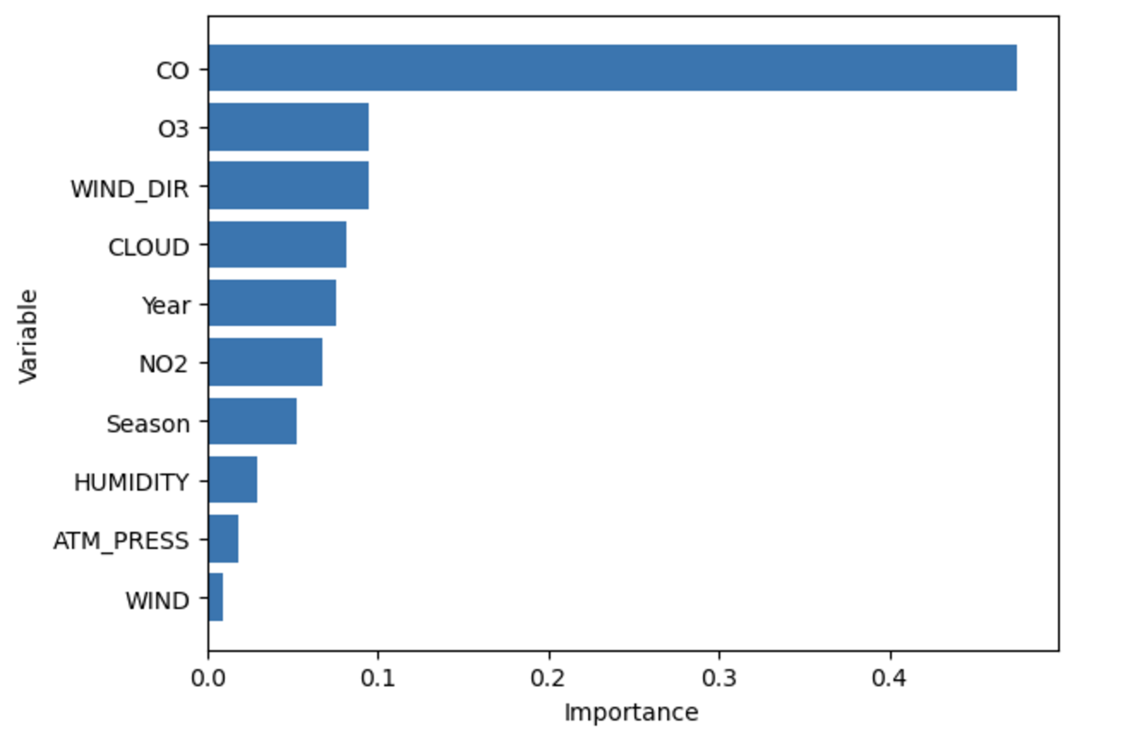
Model Evaluation
Random Forest model is better for this case since it has higher test score rate and low MSE, RMSE, MAE, MAPE values.
Feature Importance
Random Forest
Gradient Boosting
Both in the Random Forest model and Gradient Boost model have CO and O3 as the highest feature Importance.

Slide 19
Conclusion
Analysis Result - PM10 levels have a weak correlation with weather-related variables and a strong correlation with atmospheric-related variables. - Seasons play a significant role in relation to PM10, especially showing high PM10 in winter. - Based on the 8-direction wind criteria, fine dust concentrations are particularly high in cases of west and southwest winds, categorized as 'Bad' or 'Very Bad'.
Prediction Model - Used Multiple Regression Analysis, Random Forest, Gradient Boosting to devise the prediction model - Random Forest showed comparatively high accuracy. - Shared Key Influential Variables : CO, O3
Notes:
PM10 CO 계절 HUMIDITY TEMP ATM_PRESS WINDDIR SO2

Slide 20
Appendix
# | Variable | Details | Type | Reason for excluding | EDA |  |  | Modelling
 |  |  |  |  | Graph | Statistic Analysis | Correlation Analysis | Regression | RF | GB
1 | MeasDate | Measured Date | Continuous | -
2 | PM10 | Particulate Matter 10㎍/㎥ | Continuous |  | line, histogram
3 | O3 | Ozone Concentration | Continuous | Indirect Influence | heatmap, box plot, scatterplot |  | O | O
4 | NO2 | Nitrogen Dioxide Concentration | Continuous |  | heatmap, box plot, scatterplot |  | O | O | O | O
5 | CO | Nitric Oxide Concentration | Continuous |  | heatmap, box plot, scatterplot |  | O | O | O | O
6 | SO2 | Sulfur Dioxide Concentration | Continuous |  | heatmap, box plot, scatterplot |  | O |  | O | O
7 | TEMP | Temperature (°C) | Continuous |  | heatmap |  | O | O | O | O
8 | RAIN | Precipitation (mm) | Continuous | Low Correlation | heatmap | 2 sample t-test
9 | WIND | Wind Speed (m/s) | Continuous | *Converted to Categorical | heatmap, box plot, pie chart |  | O |  | O | O
10 | WIND_DIR | Wind Direction (16Cardinal Directions) | Continuous | *Converted to Categorical | heatmap, box plot, pie chart |  | O | O | O | O
11 | HUMIDITY | Humidity(%) | Continuous |  | heatmap |  |  |  | O | O
12 | ATM_PRESS | Atmospheric Pressure(hPa) | Continuous | *Converted to Categorical | heatmap |  |  | O | O | O
13 | SNOW | Snowfall(cm) | Continuous | Low Correlation | heatmap | 2 sample t-test
14 | CLOUD | Cloud Cover (in tenths) | Continuous | Low Correlation | heatmap
15 | Season | Four Seasons | Discrete |  | heatmap, box plot, histogram, bar plot | 2 sample t-test | O |  | O | O
Notes:
PM10 CO 계절 HUMIDITY TEMP ATM_PRESS WINDDIR SO2

Slide 21
Thank You

